Slide 1

Daniel Goleman
Psychologist and Science Journalist who popularized the concept of Emotional Intelligence (EQ) after publishing the book EI: Why It Can Matter More Than IQ, in 1995.

Slide 2
Who is Daniel Goleman?
Psychologist who lectures to professional groups, etc.
Science Journalist for the New York Times
Writer
Co-founder of the Collaborative for Academic, Social, and Emotional Learning
Co-director of the Consortium for Research on Emotional Intelligence in Organizations.
Board Member of the Mind & Life Institute

Slide 3

Marshmallow Story
What is it?
A video of the experiment
Goleman Conducted an experiment on young children with marshmallows
He believed that their reaction to whether or not they ate the marshmallow would identify their success in the future.

Slide 4

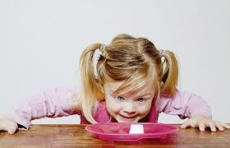
What does the Research Tell Us?
Who Waited:
Who Ate:
Popular
More Adventurous
More Confident
Stubborn
Easily Frustrated
Lonely

Slide 5
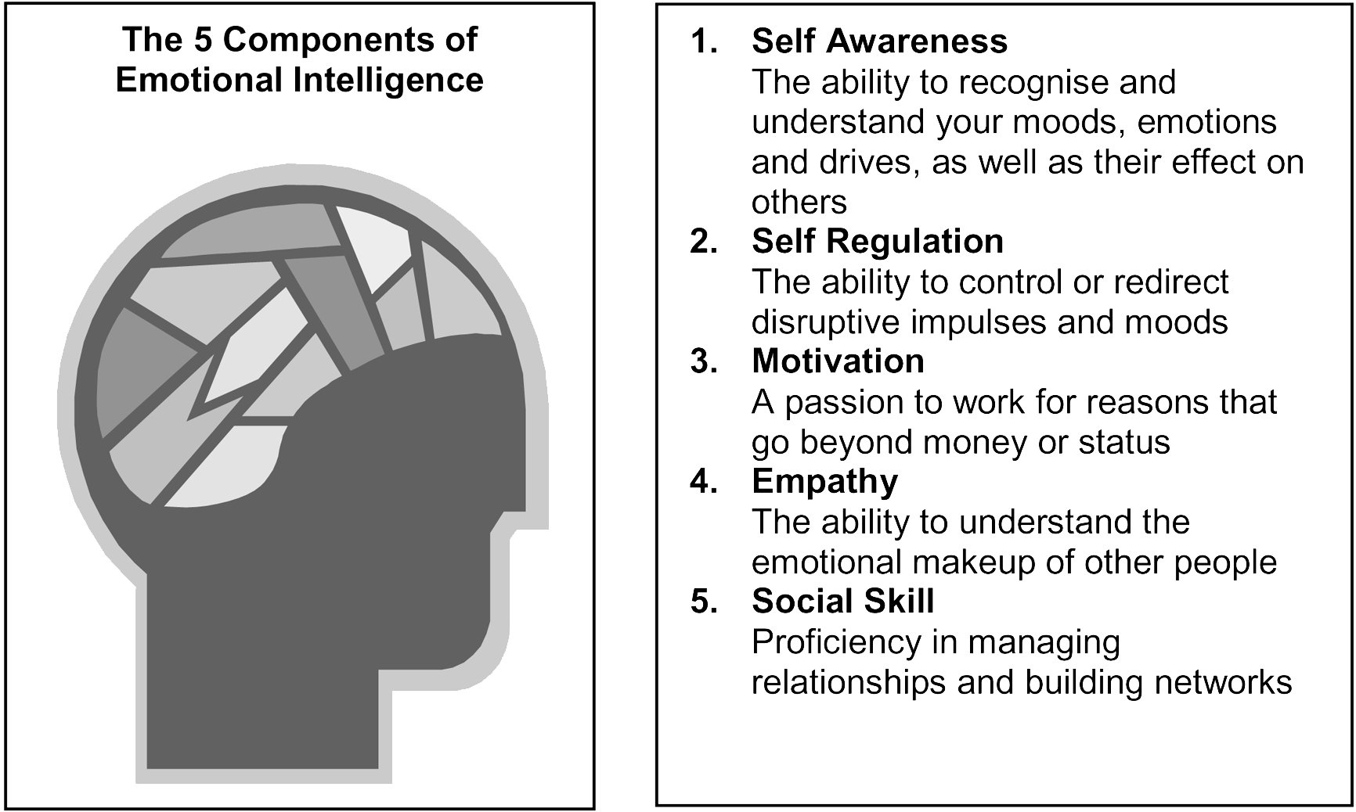
5 Components of EQ:

Slide 6
What Information Can EQ Give Us?
Self Control
Manage Stress
Achieve Success

Slide 7

How Does Emotional Intelligence (EQ) Influence Teaching & Learning?
Increasing the range of diversity of educational ideas
IQ & EQ can capture the range of their abilities and skills
Include lesson plans involving EQ to better the teaching atmosphere.

Slide 8
Name Game
Smart
Adventurous
Responsible
Attentive
Hard working
Honest
Alert
Respectful
Patient
Energetic
Reliable
Reliable
Understanding
Trustworthy
Helful
Sweet
Thoughtful
Appreciative
Relaxed
Nice
Even Tempered
Supportive

Slide 9

Can you manage your emotions?

Slide 10
References
Teachers, Schools, And Society A Brief Introduction of Education Third Edition David Miller Sadker Karen R. Zittleman
http://danielgoleman.info/biography/
http://myextension.uiuc.edu
http://www.edutopia.org/emotional-intelligence-research
http://www.worshiphousemedia.com/mini-movies/14675/The-Marshmallow-Test

